Slide 1
SECURE DATA HIDING IN IMAGE USING THE STEGANOGRAPHY
CAPSTONE PROJECT
PRESENTED BY
STUDENT NAME : SUBANESH.S
COLLAGE NAME & DEPARTMENT : SRM UNIVERSITY KATTANKULATHUR – CHENNAI & ECE-CORE

Slide 2
OUTLINE
Problem Statement
Technology used
Wow factor
End users
Result
Conclusion
Git-hub Link
Future scope

Slide 3
Problem Statement
Implement a system that hides a secret message within an image using steganography. The message is encoded in the least significant bits (LSB) of the image's pixels, and it can later be decoded using a password.
Encoding:
Input:An image file
Process: Convert the message and password to binary, and hide them within the image pixels.
Output: A new image.
Decoding:
Input:The encoded image and the password.
Process: Extract the password from the image to locate the hidden message.
Output: The decoded message, displayed as a string.
This system ensures data confidentiality by using a password for decoding and hiding the message securely in the image.

Slide 4
Technology used
Python: Programming language for implementing the steganography system.
PIL (Pillow): Python Imaging Library to handle image manipulation (opening, modifying, and saving images).
Binary Encoding: Used to convert the secret message and password into binary data, which is then embedded in the image.
Least Significant Bit (LSB) Technique: Hides the secret message in the least significant bit of the image's RGB pixel values.
Input/Output Operations: Handling user input (image name, message, password) and saving the encoded/decoded images.

Slide 5
Wow factors
Invisible Security: The hidden message is embedded in plain sight, making it undetectable to the human eye. Only those with the correct password can decode the message.
Data Confidentiality: Steganography allows sensitive information (like passwords, secret notes, etc.) to be securely hidden within everyday images, adding an extra layer of privacy.
Real-World Application: This technique is used in security, digital watermarking, and even online communication to hide data in a way that avoids detection.
Simplicity & Effectiveness: A simple image can store significant amounts of hidden data, making it both an elegant and practical solution for secure data transmission.

Slide 6
End users
Security Professionals: Hide sensitive data like passwords and encryption keys to prevent unauthorized access.
Digital Forensics Experts: Detect hidden messages during investigations.
Privacy Advocates: Send private messages securely without detection.
Content Creators/Artists: Embed watermarks or copyright info to protect intellectual property.
Businesses: Secure internal communication and sensitive business data.
Everyday Users: Send secure, covert messages over social media or email.

Slide 7
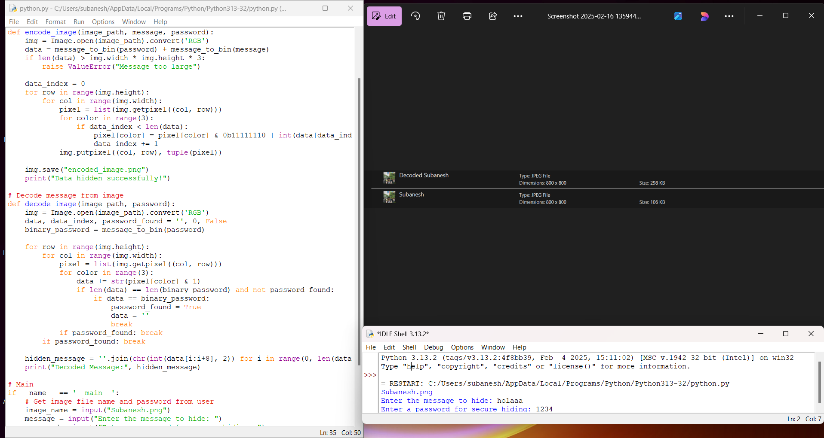
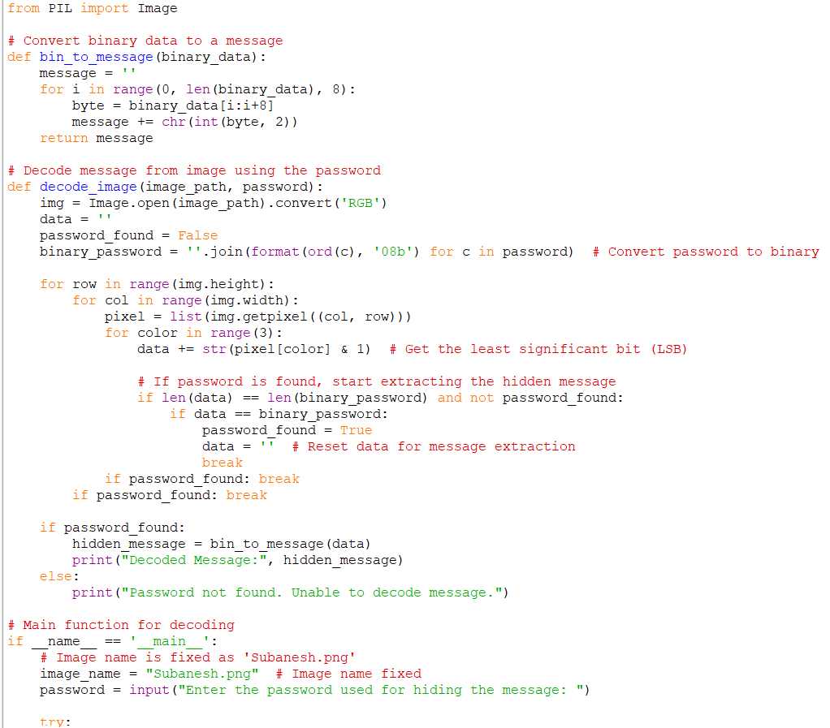
Results

Slide 8
Conclusion
In this project, we implemented a secure image steganography system that hides sensitive messages within image files using the Least Significant Bit (LSB) technique. By embedding the secret data into the image pixels, we ensure that the message remains undetectable to the naked eye, offering a high level of confidentiality.
Encoding: The message and password are securely encoded into the image, ensuring only authorized users with the correct password can retrieve the hidden information.
Decoding: Using the password, the hidden message is extracted, providing an efficient and secure method of communication.
This project demonstrates the power of steganography in ensuring data privacy, with potential applications in fields like digital security, privacy protection, and intellectual property safeguarding. With its simplicity and effectiveness, this method allows users to safely transmit sensitive data without the risk of detection.

Slide 9
GitHub Link
https://github.com/subaneshselvam/Steganography-Project.git

Slide 10
Future scope(optional)
Enhanced Security: Combining stronger encryption with steganography for added protection.
AI Detection: Using machine learning to detect and decode hidden messages automatically.
Multimedia Steganography: Expanding to audio, video, and AR for versatile data hiding.
Legal & Compliance: Secure document tracking and watermarking for copyright protection.
Blockchain Integration: Using steganography in blockchain for secure, immutable data storage.

Slide 11
THANK YOU

